Slide 1


BUILDING A
DEDICATED MICROPROCESSOR
DANSO ISAAC
ahabnnie@gmail.com, isaacdanso2001@gmail.com
INTERNSHIP
TRAINING
PRESENTATION ON DESIGNING A DEDICATED MICROPROCESSOR AND IMPLEMENTING IT ON THE SPARTAN 3 FPGA DEVELOPMENT BOARD USING VHDL
PRESENTATION

Slide 2
PROBLEM STATEMENT
Design a dedicated Datapath for inputting three 8-bit unsigned numbers, and then output the smallest number
PRESENTATION

Slide 3
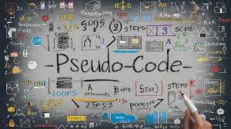
GENERATED
PSEUDOCODE
input A, B, C;
if(A < B){
E = A;
}
else {
E = B;
}
if(E < C){
Y = E;
}
else {
Y = C;
}
output Y;}

Slide 4
CONTROL TABLE
INSTRUCTIONS | ELOAD | LOAD | MUXSEL1 | MUXSEL2 | OUTPUT_ENABLE | Q2Q1Q0
INPUT A, B, C | 0 | 1 | x | x | 0 | 000
NO OPERATION | 0 | 0 | x | x | 0 | 001
E = A | 1 | 0 | 1 | x | 0 | 010
E = B | 1 | 0 | 0 | x | 0 | 011
E | 0 | 0 | x | x | 0 | 100
Y = E, OUTPUT Y | 0 | 0 | x | x | 1 | 101
Y = C, OUTPUT Y | 0 | 0 | x | 1 | 1 | 110

Slide 5


WPS TEMPLATE
Short description
01
Short description
Presentations are communication tools that can be used as speeches, reports, and more.
80%
Presentations are communication tools that can be used as speeches, reports, and more.
BUSINESS
TRAINING
02
Short description
Presentations are communication tools that can be used as speeches, reports, and more.
Presentations are communication tools that can be used as speeches, reports, and more.

Slide 6

DATAPATH
short
description
Presentations are communication tools.
Add a short description
Presentations are communication tools that can be used as demonstrations, lectures, speeches, reports, and more. Most of the time, they're presented before an audience.
Description

Slide 7

STATE DIAGRAM

Slide 8

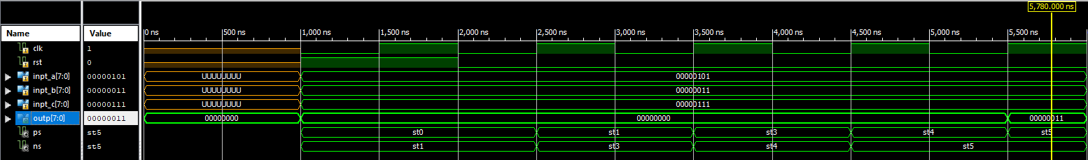
WPS TEMPLATE
SIMULATION RESULT
Add a short Description
Presentations are communication tools that can be used as demonstrations, lectures, speeches, reports, and more. Most of the time, they're presented before an audience.

Slide 9

WPS TEMPLATE
BUSINESS
TRAINING
Add a short description
THANKS FOR WATCHING
Business Training Template
BUSINESS
TRAINING
BUSINESS
TRAINING
Presented to:
Company Name
Prepared by:
Agency Name
Presentations are communication tools that can be used as speeches, reports, and more.
PRESENTATION

